Slide 1


GIT
SDET Fundamental Training

Slide 2

A Brief History
Linus Torvalds uses BitKeeper to manage Linux code
Ran into BitKeeper licensing issue
Liked functionality
Looked at CVS as how not to do things
April 5, 2005 - Linus sends out email showing first version
June 15, 2005 - Git used for Linux version control

Slide 3


GIT is not SCM
“Never mind merging. It's not an SCM, it's a distribution and archival mechanism. I bet you could make a reasonable SCM on top of it, though. Another way of looking at it is to say that it's really a content-addressable filesystem, used to track directory trees.”
Linus Torvalds, April 7, 2005

Slide 4
Centralized Version Control
Traditional version control system
Server with database
Clients have a working version
Examples
CVS
Subversion
Visual Source Safe
Challenges
Multi-developer conflicts
Client/server communication

Slide 5
Centralized Version Control
Resilience: No one repository has more data than any other
Speed: Very fast operations compared to other VCS
Space: Compression can be done across repository not just per file; Minimizes local size as well as push/pull data transfers
Simplicity: Object model is very simple
Large userbase with robust tools

Slide 6
Disadvantages
Definite learning curve, especially for those used to centralized systems. It can sometimes seem overwhelming to learn.
Conceptual difference
Huge amount of commends

Slide 7
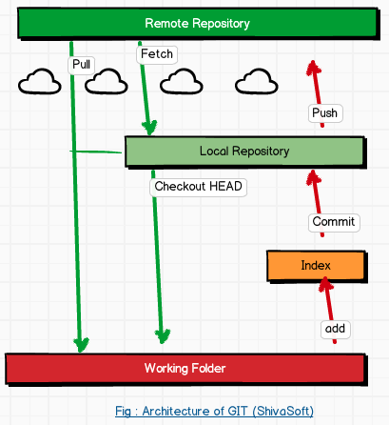
GIT Architecture

Slide 8

Before that lets Install
You can download GIT from
https://git-scm.com/downloads
Latest Version : 2.4.2

Slide 9
Getting Started
A basic workflow
(Possible init or clone) Init a repo
Edit files
Stage the changes
Review your changes
Commit the changes

Slide 10
git init
The git init command creates a new Git repository.
It can be used to convert an existing, unversioned project to a Git repository or initialize a new empty repository.
Executing git init creates a .git subdirectory in the project root, which contains all of the necessary metadata for the repo.
View with ls -la

Slide 11
git init
git init <directory>
Above command will create an empty Git repository in the specified directory. Running this command will create a new folder called <directory> containing nothing but the .git subdirectory.

Slide 12
git bare
Syntax: git init --bare <directory>
Example: git init –bare my-project.git
Initialize an empty Git repository, but omit the working directory.
Shared repositories should always be created with the --bare flag
Conventionally, repositories initialized with the --bare flag end in .git.

Slide 13

Bare Repositories
The --bare flag creates a repository that doesn’t have a working directory, making it impossible to edit files and commit changes in that repository.
Central repositories should always be created as bare repositories because pushing branches to a non-bare repository has the potential to overwrite changes
Virtually all Git workflows, the central repository is bare, and developers local repositories are non-bare.

Slide 14
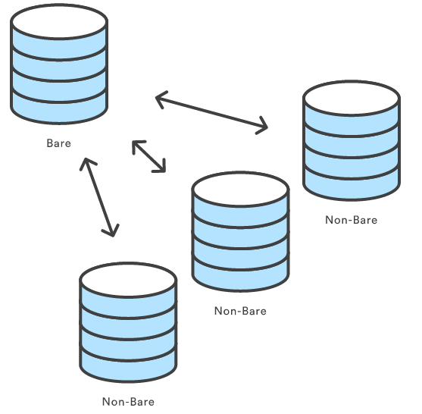
Bare Repositories

Slide 15
git clone
The git clone command copies an existing Git repository(This is sort of like svn checkout).
Git repository—it has its own history, manages its own files, and is a completely isolated environment from the original repository.
Usage : git clone <repo>
a remote machine accessible via HTTP or SSH.
git clone <repo> <directory>
Clone the repository located at <repo> into the folder called <directory> on the local machine.

Slide 16
GIT vs SVN
Unlike SVN, Git makes no distinction between the working copy and the central repository—they are all full-fledged Git repositories.
SVN depends on the relationship between the central repository and the working copy, Git’s collaboration model is based on repository-to-repository interaction.
In GIT you push or pull commits from one repository to another.

Slide 17
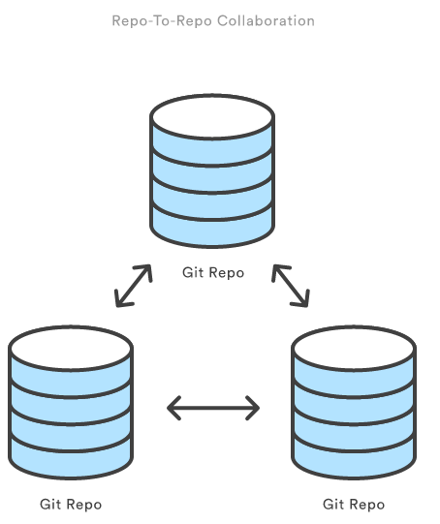
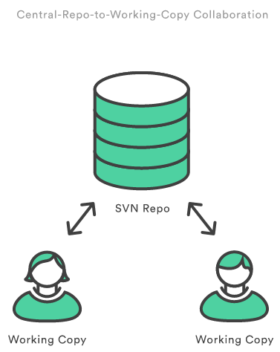
GIT vs SVN

Slide 18
git config
the git config command lets you configure your Git installation (or an individual repository) from the command line.
Usage: git config user.name <name>
Define the author name to be used for all commits in the current repository.
Typically, you’ll want to use the --global flag to set configuration options for the current user.

Slide 19
git config
git config --global user.name <name>
Define the author name to be used for all commits by the current user.
git config --global user.email <email>
Define the author email to be used for all commits by the current user.
git config --global alias.<alias-name> <git-command>
Create a shortcut for a Git command.

Slide 20
git config
git config --system core.editor <editor>
Define the text editor used by commands Note: editor : vim, notepad.exe etc
git config --global --edit
Open the global configuration file in a text editor for manual editing.

Slide 21

git config
Git stores configuration options in three separate files, which lets you scope options to individual repositories, users, or the entire system:
<repo>/.git/config – Repository-specific settings.

Slide 22
git add
The git add command adds a change in the working directory to the staging area.
However, git add doesn't really affect the repository in any significant way—changes are not actually recorded until you run git commit.
Usage : git add <file>
Stage all changes in <file> for the next commit.
git add <directory>
Stage all changes in <file> for the next commit.

Slide 23
git add
Example
When you’re starting a new project, git add serves the same function as svn import.
git add . (dot for all files)
git commit
For Individual File
git add Hello.java
git commit

Slide 24
Stage Area
It helps to think of it as a buffer between the working directory and the project history.

Slide 25
git commit
Snapshots are always committed to the local repository. This is fundamentally different from SVN, wherein the working copy is committed to the central repository.
Just as the staging area is a buffer between the working directory and the project history, each developer’s local repository is a buffer between their contributions and the central repository.

Slide 26
Inspecting a Repository
git status
The git status command displays the state of the working directory and the staging area.
It lets you see which changes have been staged, which haven’t, and which files aren’t being tracked by Git.
Usage: git status

Slide 27
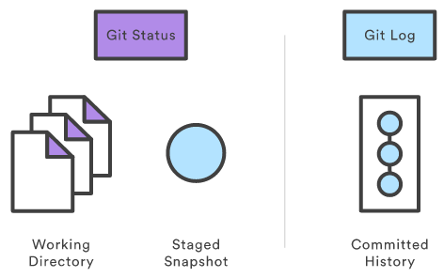
Inspecting a Repository
git log
The git log command displays committed snapshots.
It lets you list the project history, filter it, and search for specific changes.
While git status lets you inspect the working directory and the staging area.

Slide 28
Customized git log
git log Display the entire commit history using the default formatting.
git log -n <limit> Limit the number of commits by <limit>. For example, git log -n 3 will display only 3 commits.
git log –oneline Condense each commit to a single line.

Slide 29
Customized git log
git log –stat Along with the ordinary git log information, include which files were altered
git log -p
Display the patch representing each commit.
git log --author="<pattern>“ Search for commits by a particular author.

Slide 30
Customized git log
git log --grep="<pattern>" Search for commits with a commit message that matches <pattern>
git log <file> Only display commits that include the specified file.
git log --graph --decorate –oneline
--graph flag that will draw a text based graph of the commits --decorate adds the names of branches or tags of the commits that are shown.

Slide 31
Viewing old commits
The git checkout command serves three distinct functions: checking out files, checking out commits, and checking out branches.
Lets concentrate only on two, later on branches

Slide 32
Viewing old commits
Usage: git checkout master
Return to the master branch.
Usage: git checkout <commit> <file>
Example: git checkout a1e8fb5 Hello.java
Check out a previous version of a file.

Slide 33
Viewing old commits
Usage: git checkout <commit>
Example: git checkout a1e8fb5
Update all files in the working directory to match the specified commit.
You can check out the most recent version with the following:
Example: git checkout HEAD Hello.java

Slide 34
SVN vs GIT
SVN uses a single central repository to serve as the communication
This is different from Git’s collaboration model, which gives every developer their own copy of the repository, complete with its own local history and branch structure.
Git lets you share entire branches between repositories.

